Slide 1
Data Structure and Algorithms
Azaz Ahmed Kiani

Slide 2
Link-List Lesson 10
2

Slide 3
List Using Linked Memory
Various cells of memory are not allocated consecutively in memory.
With arrays, the second element was right next to the first element.
Now the first element must explicitly tell us where to look for the second element.
Do this by holding the memory address of the second element

Slide 4
Linked List
Pointer Based Implementation of Linked List ADT
Dynamically allocated data structures can be linked together to form a chain.
A linked list is a series of connected nodes (or links) where each node is a data structure.
A linked list can grow or shrink in size as the program runs.
This is possible because the nodes in a linked list are dynamically allocated

Slide 5
Composition of Linked List
Each node in the linked list contains –
a) One or more members that represent data
b) A pointer, that can point to another node.
Data Members Pointer

Slide 6
Composition of linked List
A linked list is called “linked” because each node in the series (i.e. the chain) has a pointer to the next node in the list, e.g.
NULL
Head
a) The head is a pointer to the first node in the list.
b) Each node in the list points to the next node in the list.
c) The last node points to NULL (the usual way to signify the end).
Note, the nodes in a linked list can be spread out over the memory.

Slide 7
Linked List
Actual picture in memory:
1051
6
1052
1063
current
1053
1063
1054
2
head
1055
1051
1056
2
6
8
7
1
1057
7
1058
1060
current
1059
1060
1
1061
0
head
1062
1054
1063
8
1064
1057
1065
Notes:
End of lecture 2
The second goal is the “nuts and bolts” of the course.
The third goal prepares a student for the future.

Slide 8
List Declarations
How to declare a linked list in C or C++?
Step 1) Declare a data structure for the nodes.
e.g. the following struct could be used to create a list -
struct ListNode
{
int data;
ListNode *next;
};

Slide 9
List Declarations
a) The first member of the ListNode struct is a int called data.
It is to hold the node’s data.
b) The second member is a pointer called next.
It is to hold the address of any object that is a ListNode struct.
Hence each ListNode struct can point to the next one in the list.
The ListNode struct contains a pointer to an object of the same type
as that being declared. It is called a self-referential data structure.
This makes it possible to create nodes that point to other nodes of
the same type.

Slide 10
List Declarations
Step 2) Declare a pointer to serve as the list head, e.g
List *head;
Before you use the head pointer, make sure it is initialized to NULL,
so that it marks the end of the list.
Once you have done these 2 steps
(i.e. declared a node data structure, and
created a NULL head pointer, you have an empty linked list.
struct ListNode { int data; ListNode *next; }; ListNode *head; // List head pointer

Slide 11
Singly Linked List (SLL) - More Terminology
A node’s successor is the next node in the sequence
The last node has no successor
A node’s predecessor is the previous node in the sequence
The first node has no predecessor
A list’s length is the number of elements in it
A list may be empty (contain no elements)
Head
87
34
78
65

Slide 12
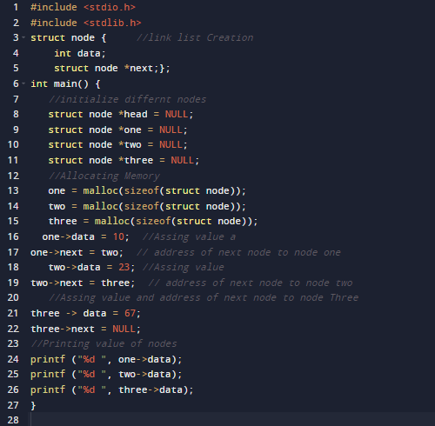

Link List Creation in C (Simple method)

Slide 13
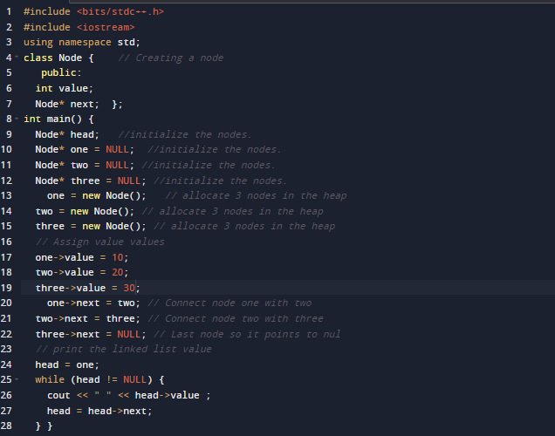

Link List Creation in C ++ (Simple method)

Slide 14
Traversing a SLL (animation)
nodePtr
Head
67
87
98

Slide 15
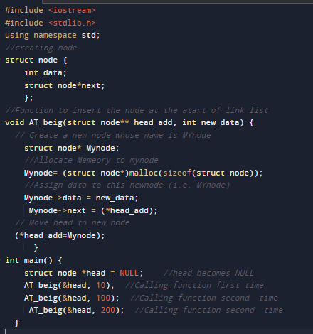

Insert a New Node at Beginning of Link-List

Slide 16
Insert a New Node at the END of Link-List
// Insert node at the end f Link-List
void insertend(struct node** head_add, int newdata) { // Function to insert at end
struct node* Mynode;
Mynode = (struct node*)malloc(sizeof(struct node)); //This a new node and memory allocation
struct node* last = *head_add;
Mynode->data = newdata; // Assigning data to this new node
Mynode->next = NULL;
if (*head_add == NULL) { // check condition
*head_add = Mynode;
return;
}
while (last->next != NULL) last = last->next;
last->next = Mynode;
return; }

Slide 17
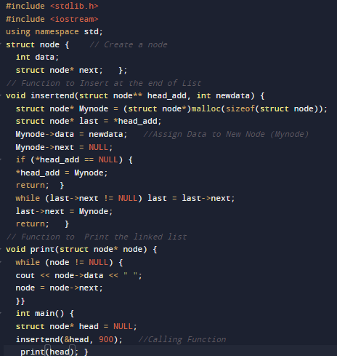
Insert a New Node at the END of Link-List (Complete Programme)

Slide 18
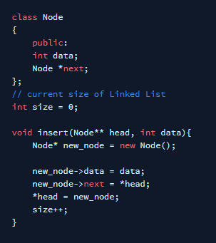
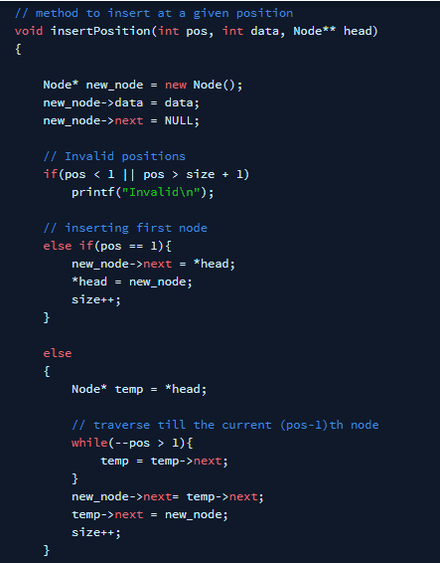
Insert a New Node at the At Given Position

Slide 19
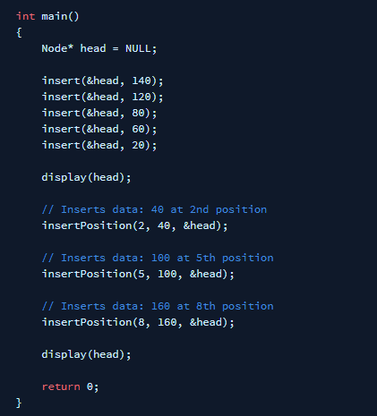

Insert a New Node at the At Given Position

Slide 20
Inserting after (animation)
nodePtr
78
Head
56
67
93
Find the node you want to insert after
First, copy the link from the node that's already in the list
Then, change the link in the node that's already in the list

Slide 21
Deleting an element from a SLL
• To delete the first element, change the link in the header
Head
56
67
93
• To delete some other element, change the link in its predecessor
Head
(predecessor)
56
67
93

Slide 22
Delete a Node at the Given Position
// Delete node at the given Position
void delete(struct Node **head_add, int pos) { //Function to delete a node
if (*head_add == NULL) { //Check whether Link List is empty
return; }
struct Node* temp = *head_add;
if (pos == 1) { //At First Position
*head_add = temp->next;
free(temp);
return;
}
for (int i = 2; temp != NULL && i < pos ; i++) { //At Given or user defined position
temp = temp->next;
}
if (temp == NULL || temp->next == NULL) {
return;
}
struct Node *next = temp->next->next; //Deletes the Node
free(temp->next);
temp->next = next;
}

Slide 23
Home Exercise
Write a C ++ Programme to create a link-list and insert at least four nodes and then delete the node at position 2.
Write a C++ Programme to search a value from link-list

Slide 24
Summary…
Questions…?

